Slide 1
Product Management Metrics
Presenter:
Virat Singh

Slide 2
Real Interview Question
You’re a PM at YouTube. What metrics
would you put on your dashboard to
make YouTube more successful?

Slide 3

Why does this matter?
Agenda
Sample interview questions
Framework
Live mock

Slide 4






About me
Virat Singh
Product @ Microsoft, Razorpay
SWE @ Amazon, Meta
President, BTC @ ISB

Slide 5
“What cannot be measured cannot be managed.”

Slide 6

D30
ARPU
LTV
GMV
AOV
MRR
CAC
CES
MAU
CSAT
CTR
NPS

Slide 7
Real interview questions
Measure the success of Instagram stories.
Is ChatGPT in trouble or thriving?
What metrics would you prioritize for Spotify?

Slide 8
Framework
Clarity & Main Goal
1
PIRATE Structure
2
Industry Alignment
3
Metric Trees
4
Follow-up
5

Slide 9
Framework
Clarity & Main Goal – Clarification Questions
Understand everything
about the question
1
PIRATE Structure
2
Industry Alignment
3
Metric Trees
4
Follow-up
5

Slide 10
Clarification Questions
You need to clarify two things:
What is the main goal?
What is the business model?

Slide 11
Framework
Clarity & Main Goal
1
PIRATE Structure – AARRR
Define the main goal here
2
Industry Alignment
3
Metric Trees
4
Follow-up
5

Slide 12
“Pirate” – AARRR
Referral
Acquisition
Revenue
Activation
Retention

Slide 13
“Pirate” Metrics
Acquisition
Activation
Retention
Revenue
Referral
CTR
# impressions
Bounce rate
Organic traffic
  SEO / GEO
Inorganic traffic
  Promotions
CAC

Slide 14
“Pirate” Metrics
Acquisition
Activation
Retention
Revenue
Referral
Conversion rate
  Download rate
  Account created rate
Time to first purchase / action
  CES
Trial-to-purchase ratio

Slide 15
“Pirate” Metrics
Acquisition
Activation
Retention
Revenue
Referral
Also called “engagement”
DAU / WAU / MAU
Stickiness
D1 / D7 / D30 retention
Churn rate
Time-on-site
# actions per session

Slide 16
“Pirate” Metrics
Acquisition
Activation
Retention
Revenue
Referral
MRR
CAC : LTV
ARPU / ARPPU
GMV
  AOV
  # transactions
CPM, CPC, CTR
Prices

Slide 17
“Pirate” Metrics
Acquisition
Activation
Retention
Revenue
Referral
CSAT & NPS
Referral links
  Capital k > 1
Positivity score
  NLP on corpus

Slide 18
Framework
Clarity & Main Goal
1
PIRATE Structure
2
Industry Alignment & Deep-Dive
Define the business model here
3
Metric Trees
4
Follow-up
5

Slide 19





Most-Asked Industries
Subscriptions
Ads
Software-as-a-Service (SaaS)
Two-sided Markets
E-commerce

Slide 20
Framework
Clarity & Main Goal
1
PIRATE Structure
2
Industry Alignment
3
Metric Trees (L₀, L₁, L₂) – Construct layers
Combine main goal + business model
4
Follow-up
5

Slide 21

Let’s see MRR in action!

Slide 22
Subscriptions / Netflix
MRR
Monthly Paying Users
x
ARPU
MAU
x
Upgrade rate
Standard pricing
+
Promotional pricing
Family discount
+
Student discount

Slide 23
Ads / Instagram
MRR
# of ads
x
$ per ad
# posts seen
x
# ads / post
CPC
x
CTR
+
CPM
# posts seen
/ minute
x
Total time-
on-site
MAU
x
Average time-on-site

Slide 24
SaaS / Slack
MRR
Monthly Paying Users
x
ARPU
MAU
x
Trial sign-ups
x
Upgrade rate
Last month’s
+
Newly acquired
-
Churned
+
Revived

Slide 25
E-commerce / Amazon
MRR
# orders
x
AOV
x
Commission %
# carts made
x
1 – abandonment rate
Abandonment rate = f (# clicks, time-to-fill, delivery options, return policies, etc.)

Slide 26
Two-Sided Markets / Uber
MRR
Total fares
x
Commission %
Average fare
x
# rides
Monthly Active Riders
x
Match rate
x
Monthly Active Drivers

Slide 27
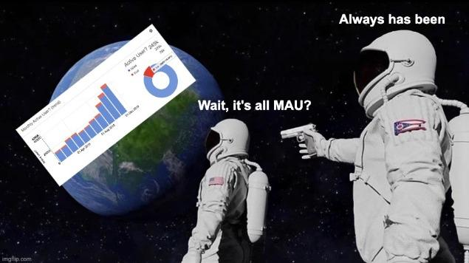

Slide 28
Shift to MAU
Lower dependence on seasonality
Consistent recurring revenue
More consumer friendly (lower upfront cost & freedom to cancel)
Correlated tightly to profits
Xbox game sales vs GamePass subscription revenue

Slide 29

Homework?? 😭
Industry | Acquisition | Activation | Retention | Revenue | Referral
Subscriptions
Ads
SaaS
E-commerce
Two-sided Markets

Slide 30
We’re done
?
.

Slide 31
Framework
Clarity & Main Goal
1
PIRATE Structure
2
Industry Alignment
3
Metric trees
4
Follow-up: A/B testing
Most common follow-ups
5

Slide 32
A/B Testing
Hypothesis
Color effects CTR
Success Criteria
Control (A)
❌
5% lift minimum
CTR is 2.3%
“Nooo, my
p-value > 0.05” 😒
CSAT / CTQs
Experiment (B)
Guardrails
Significance
CTR is 2.6%
Release

Slide 33

Questions?

Slide 34


Live mock interview! 😱
Your next task is to measure the success of YouTube.

Slide 35
What’s the industry?
Subscriptions
Ads
Software-as-a-Service (SaaS)
Two-sided Markets
E-commerce

Slide 36
Subscriptions / YouTube Premium
MRR
Monthly Paying Users
x
ARPU
MAU
x
Upgrade rate
Standard pricing
+
Promotional pricing
Family discount
+
Student discount

Slide 37
Ads / YouTube (Free)
MRR
# of ads
x
$ per ad
# videos seen
x
# ads / video
CPC
x
CTR
+
CPM
# videos seen
/ minute
x
Total time-
on-site
MAU
x
Average time-on-site

Slide 38
Placement Prep Tips
Oct W1
Product design, metrics - practice
Oct W2
Product strategy, RCA - practice
Oct W3
Guesstimates, GTM - practice
Oct W4
Mock interviews with classmates
Nov W1
Mock interviews with alums
Nov W2
Prep specifically for shortlisted companies - BTC handbook
Nov W3
Mock interviews with shortlisted company alums
Nov W4
Prioritized revision on shortlisted company question types

Slide 39

Help me with my CSAT
https://forms.gle/ovnAGxqh3kiuyzCGA

